Slide 1
DATA 698 Analytics Master's Research Project
Topic: Student Counselling Software
Irene Jacob
Student ID: 24117298

Slide 2
Introduction:
Students nowadays face various problems like stress, homesickness, exam fear etc. which in turn affects their studies and performance at school or university.
In most institutions, unfortunately there is only one counsellor for the entire student body.
To have a student counselling software, that is freely and easily accessible with a click of a button, will allow students to identify their issues and problems.

Slide 3
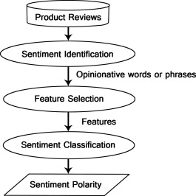
Relevant Research:
Sentiment Analysis or Opinion Mining
Student Counselling and issues that affect students these days
Use of Social Media and networking platforms
Use of Machine Learning for this problem and its analysis

Slide 4
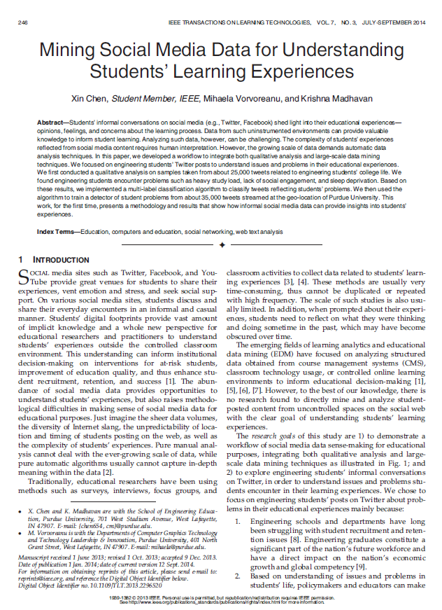
Paper Details Paper 1: Mining Social Media Data for Understanding Students’ Learning Experiences
Authors : X. Chen, M. Vorvoreanu and K. Madhavan (2014)
This paper tries to understand engineering student’s experiences with the help of different large-scale data mining techniques and qualitative methods.

Slide 5
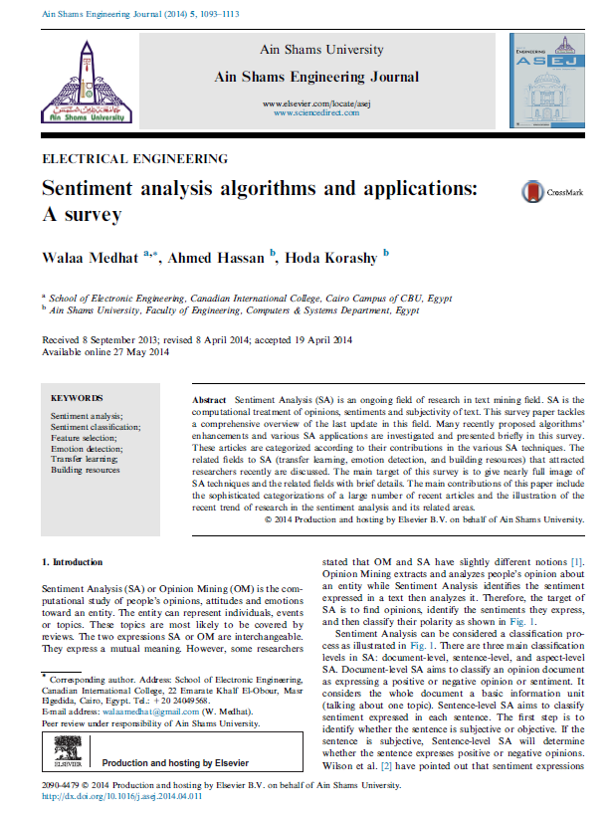
Paper Details Paper 2: Sentiment analysis algorithms and applications: A survey
Authors : Walaa Medhat, Ahmed Hassan, Hoda Korashy (2014)
This paper presents the different sentiment analysis techniques and applications in the related fields.
It categorizes many articles and illustrates the current trends of sentiment analysis.

Slide 6
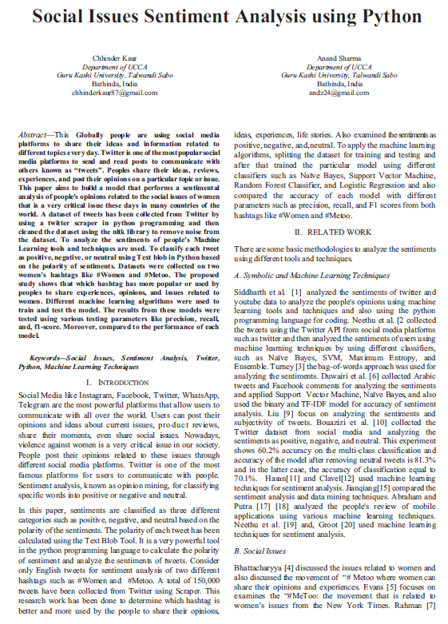
Paper Details Paper 3: Social Issues Sentiment Analysis using Python
Authors : C. Kaur and A. Sharma (2020)
This paper analyses how people express their feelings using social media platforms.
It uses Machine learning algorithms to classify the posts as negative, positive or neutral, combining both supervised and unsupervised learning algorithms to classify the emotions.

Slide 7
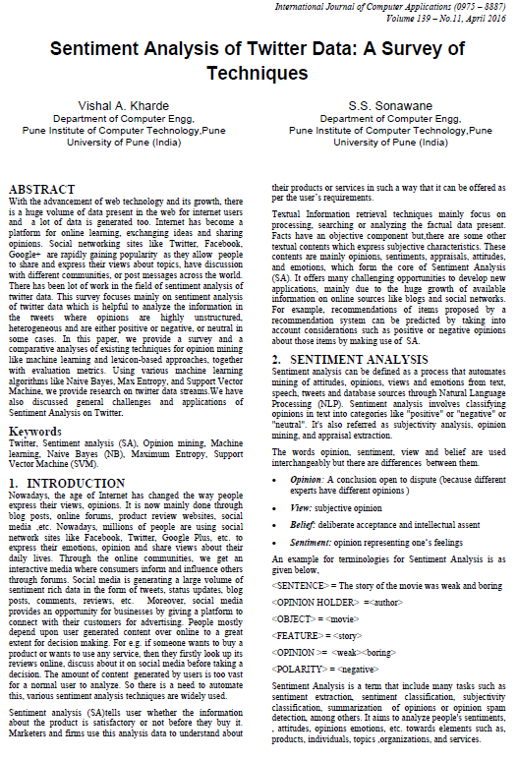
Paper Details Paper 4: Sentiment Analysis of Twitter Data: A Survey of Techniques
Authors : Kharde, Vishal & Sonawane, Sheetal (2016)
This paper provides a survey on the different methods of opinion mining such as machine learning and lexicon-based approaches.
The conclusion made from this survey suggests that Naïve Bayes and Support Vector Machine are most accurate.

Slide 8

Research Questions
To know and understand the comparison between accuracy/results of different data mining techniques
To find out why twitter is the most preferred platform compared to other social media platforms like Facebook or Instagram for data mining.
Why is python useful for analysis such as sentiment analysis?

Slide 9

Methodology
The software takes the text the user enters describing his issues as the input.
It processes this text to identify the problems faced by the student to give counsel.
The program is expected to generate the necessary advice for the client by identifying his problem (say home sickness) from the input.
The model is trained with a training set of data obtained from twitter and is expected to produce output when it encounters a new input.
Output of this software will be the prediction of the cause or root of the described issue (text input to software from student).

Slide 10


